Slide 1
Front End Engineering-I Project
Team Details:
Hiya Kashyap 2210990415
Honey Bansal 2210990416
Hunardeep Kaur 2210990417
Illu Saini 2210990418
Faculty Coordinator: Dr. Chetna Kaushal
:
Chitkara University Institute of Engineering and Technology,
Chitkara University, Punjab

Slide 2
Table of Contents
Introduction
Problem Statement
Technical Details
Key Features
Project Highlights
Bonus Feature(optional)
Conclusion
References/Links used

Slide 3
Introduction
Login authentication
is a vital process, widely followed by organizations to keep their servers safe by allowing access only to authenticated users. Every website or application demands users to complete the login authentication process to cement their credentials for security and to improve user experience.
In this project users enter their email ID/username and password to log in to the site.
Team Members:
Hiya Kashyap
Honey Bansal
Hunardeep Kaur
Illu Saini

Slide 4
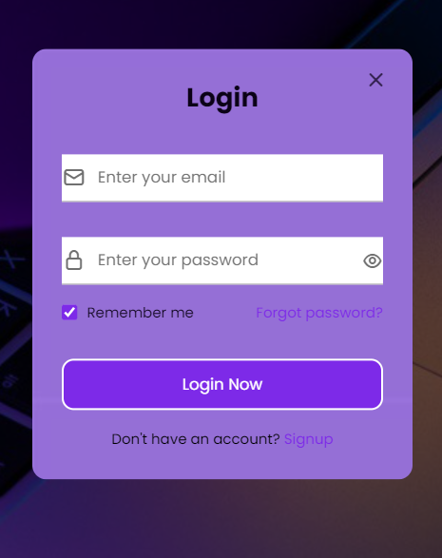
Problem Statement
Every website or application demands users to complete the login authentication process to cement their credentials for security and to improve user experience. Authentication is the process of determining whether someone or something is, in fact, who or what it says it is. It provides access control for systems by checking to see if a user's credentials match the credentials in a database of authorized users or in a data authentication server. In doing this, authentication assures secure systems, secure processes and enterprise information security.
User Login

Slide 5
Technical Details
The basic structure of website is designed using HTML.
The graphical and user experience is implemented using CSS.
The backend for the project is managed with the help of JavaScript.

Slide 6
Key Features
This slide should include Key features needed to solve the problem.
Email Login - This option enables user to login via their email address.
Login Password - User must provide password information to be collected locally on the server system. If the provided credentials match, the user is successfully authenticated.
Forgot Password – It allows users who have forgotten their password to unlock, retrieve, or reset it, usually by answering account security questions or sending them an e-mail.
Sign Up - It will create a new account using an e-mail address or a username and password if the user is not a member yet.

Slide 7
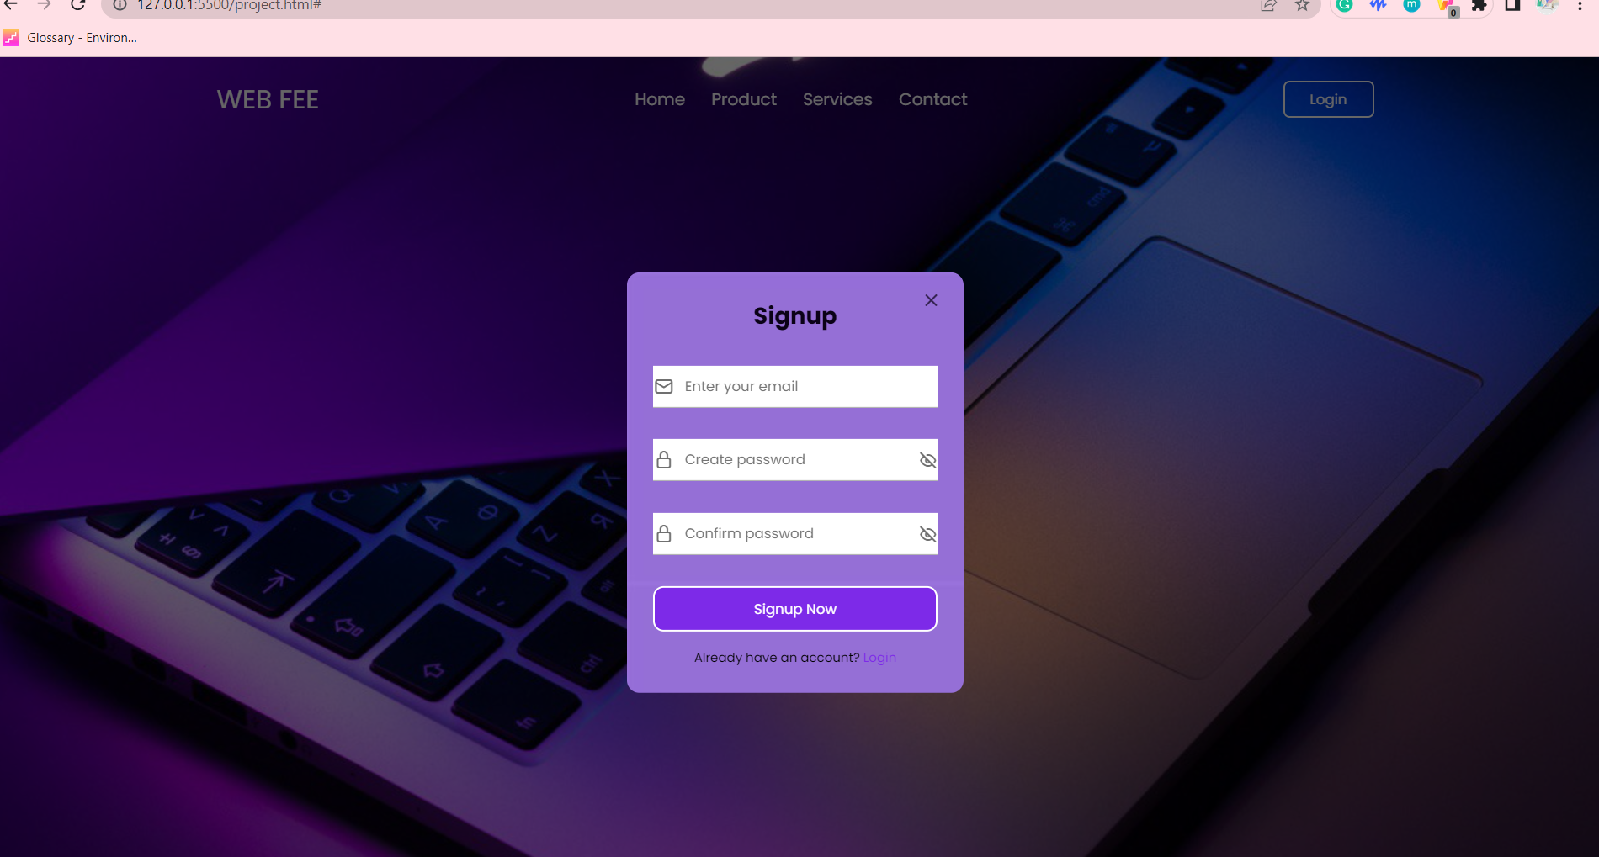
Project Highlights

Slide 8
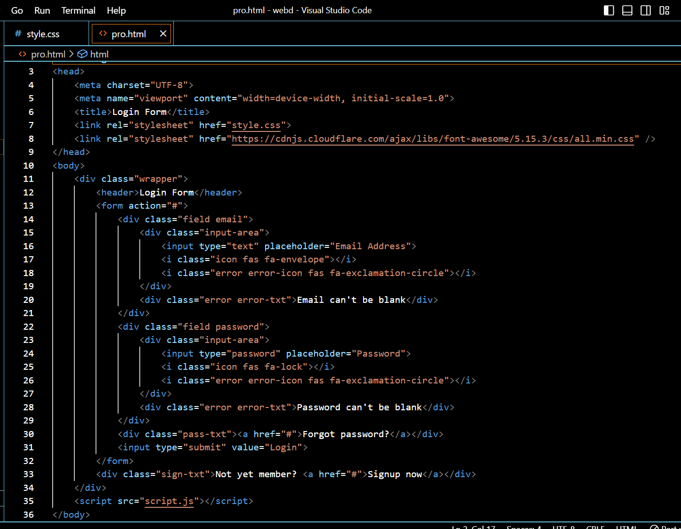

Slide 9
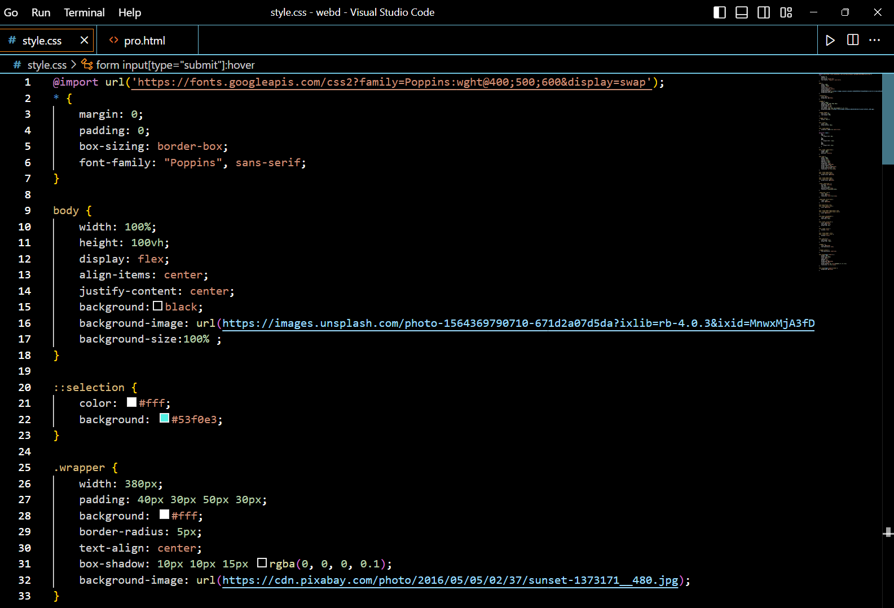
To add Background

Slide 10
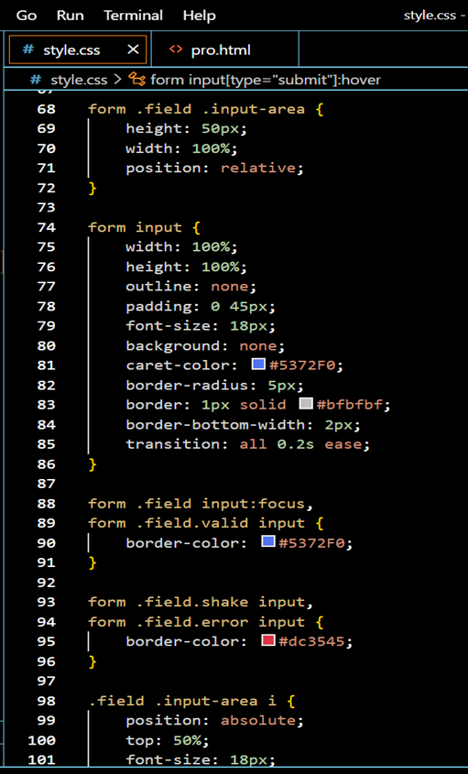
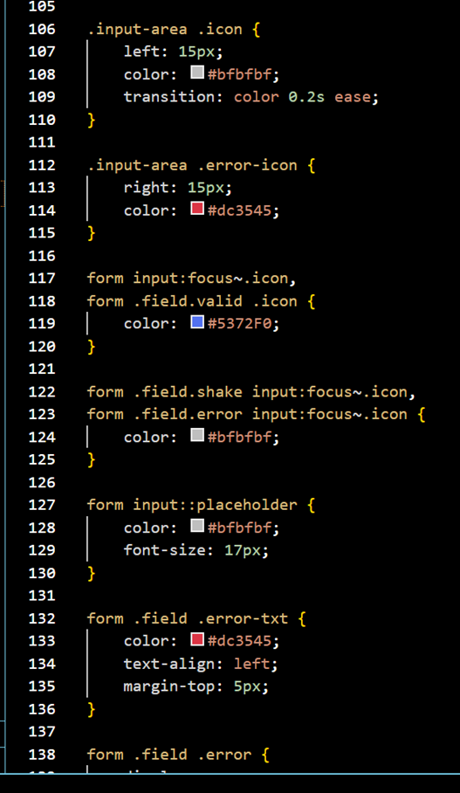

Slide 11
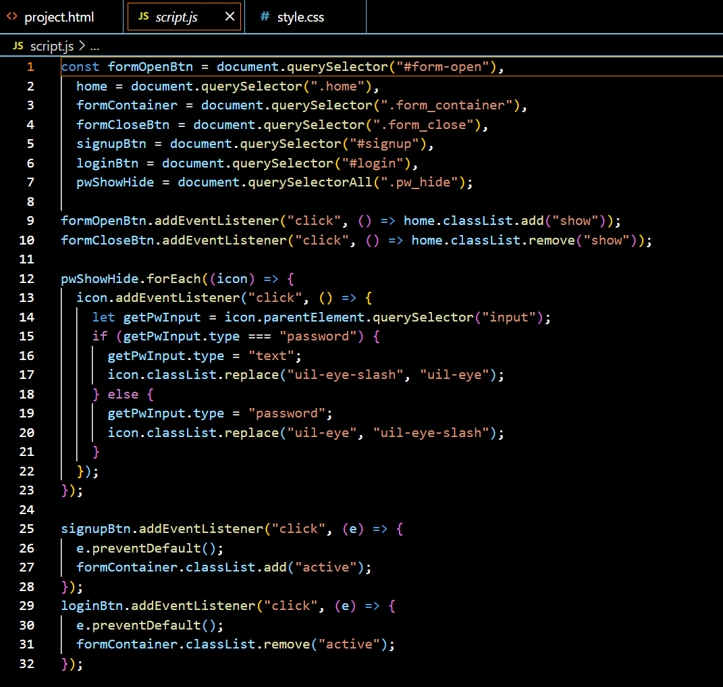

Slide 12
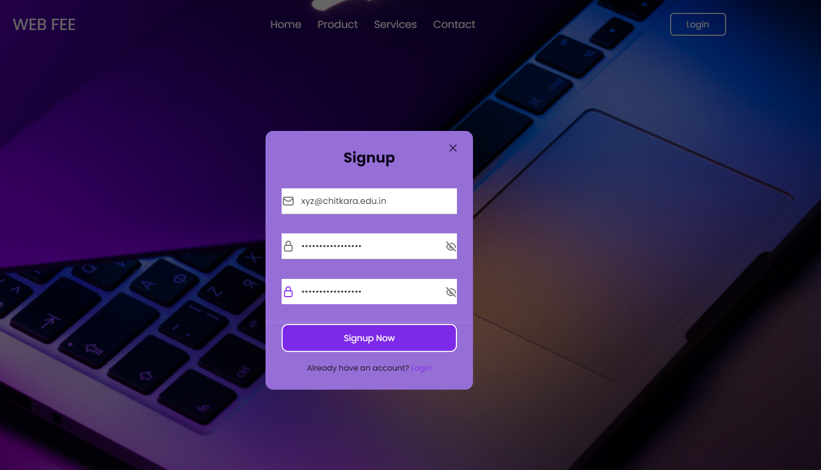

Slide 13
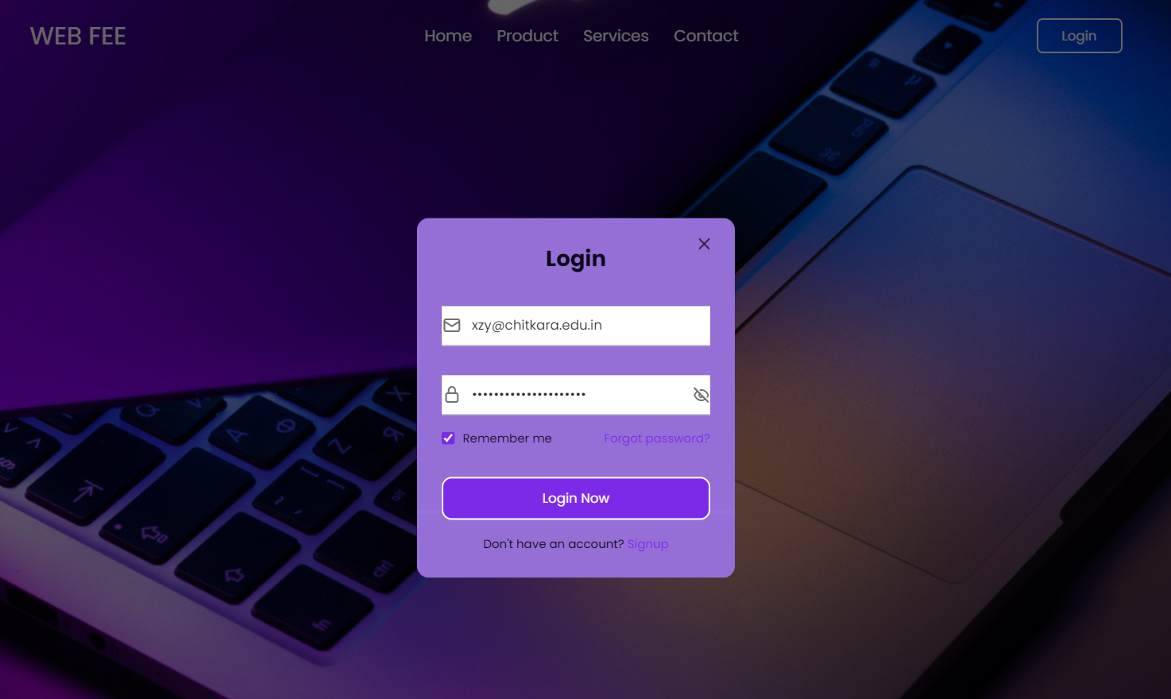

Slide 14
Conclusion
It will allow the user to login on the website and application.
The website further identifies the users with their username and password.
Login Page takes user input and passes the data to server-side program. The authentication is done by server-side program and authentication results is displayed to user on the website site login form.
If user is authenticated they are forwarded to the secure section of the website.

Slide 15
References/Links used
https://images.unsplash.com/photo-1564369790710-671d2a07d5da?ixlib=rb-4.0.3&ixid=MnwxMjA3fDB8MHxleHBsb3JlLWZlZWR8MTR8fHxlbnwwfHx8fA%3D%3D&w=1000&q=80
https://pixabay.com/photos/sunset-tree-water-silhouette-1373171/
https://external-content.duckduckgo.com/iu/?u=https%3A%2F%2Ftse1.mm.bing.net%2Fth%3Fid%3DOIP.70UUpyte0MxKQbzrrgGjPwHaEo%26pid%3DApi&f=1&ipt=613883078f0d167704a8a8493dea78a383dc66619d213c8f0a1e02b7d6ea6e60&ipo=images

Slide 16


